Slide 1
Mission
To educate, advocate, and promote
the profession and practice of
Respiratory Care

Slide 2
How Can We Promote, Connect, Network, Build a Community in a Busy Culture Today???

Slide 3
Introduction
Charity Clark
I am a mom & a wife…

Slide 4
Introduction cont.
I am a manager, a night shifter, a RRT, and a member of the AARC since I was a student in 1999…

Slide 5
Chapter VII KRCS
Currently, I am a member of the Kansas Respiratory Care Society BOD
I serve as the Chapter VII President for 2011.

Slide 6
Networking
How do Therapists in Kansas connect with each other?
How do therapists get involved in KRCS activities?
Meetings
CEU Opportunities

Slide 7
How it used to be…

Slide 8
When gas was less than $1/gallon and the price for a conference was…

Slide 9
Technology & Gas Prices
Things that keep us from traveling across the state to network with other RTs.
Busy Lives, the Economy and Gas Prices
More CEU’s offered locally
Modern Technology
Online CEUs and research

Slide 10
KRCS is NEW and EXCITING!
Revamped & Rejuvenated
New Core Strategies
Promote
Advocate
Educate

Slide 11
Virtually Visiting Kansas Therapists
How can we connect with hundreds of therapists across the state??
Visiting KS therapists virtually
Plan site visits
Contact department
Schedule a visit
Let them know why and what you will be doing with the information.
Allow time to get approval if needed.

Slide 12
Promote - Hitting the Pavement
Packing for a Road Trip!!!
Donuts
Information
AARC Applications
KRCS volunteer info
AARC Connect Info
Camera
Pictures speak volumes!!!
Be courteous – get permission to post on web!

Slide 13
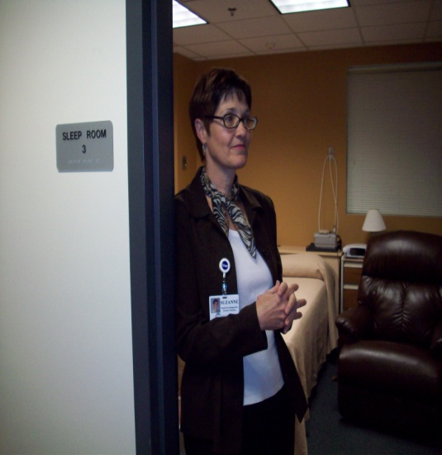
Visits & Spotlights…

Slide 14
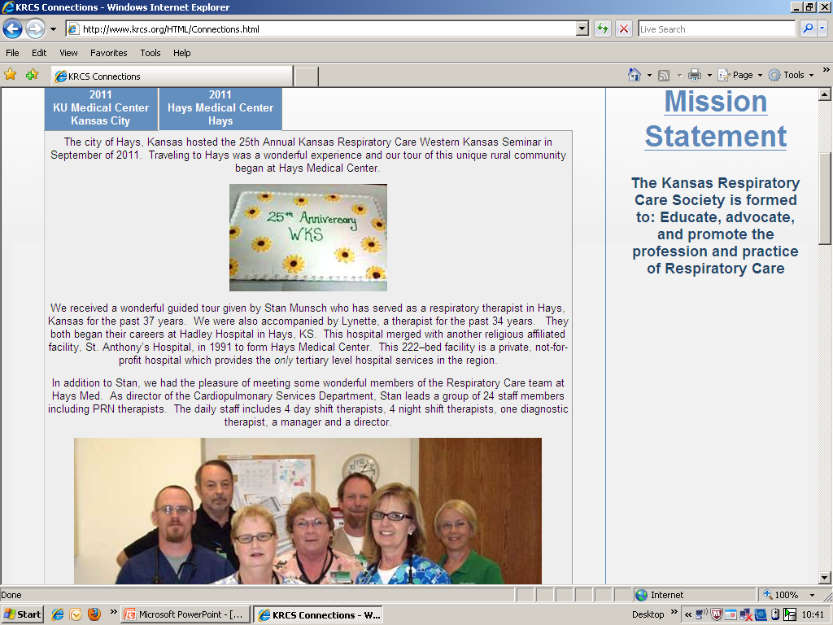
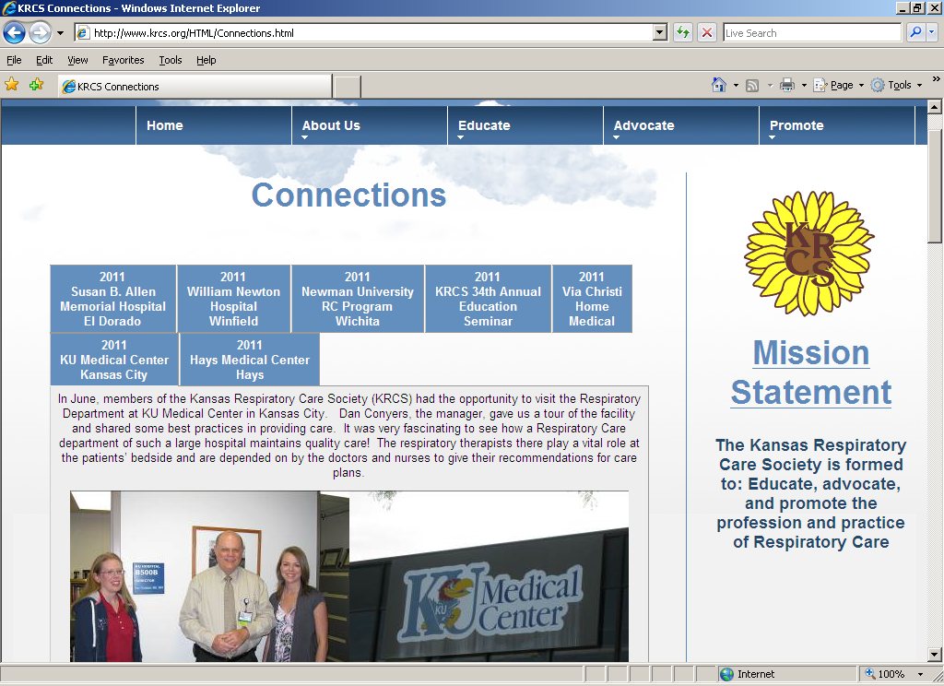
Internet Publication
Check Promote Connections on Web
www.krcs.org
Updated website
Maintained regularly
Public

Slide 15
Visiting RTs in Kansas
Therapists are fun!
Therapists are interesting!
Therapists are making great
achievements!!!!
Therapists are making a difference!

Slide 16
Therapists are not just in a department of a hospital. They are EVERYWHERE!!
University Programs
Newman University
Meg Trumpp, Program Director & current KRCS President

Slide 17
Local Conferences
2011 KRCS State Meeting - Wichita
25th Western Kansas Seminar - Hays

Slide 18
Take a Virtual Glance at What it Looks Like to Volunteer…
Drive for COPD Float at Riverfest

Slide 19
Drive4COPD Volunteers!!!

Slide 20
Encourage Other RTs to Educate the Next Generation

Slide 21
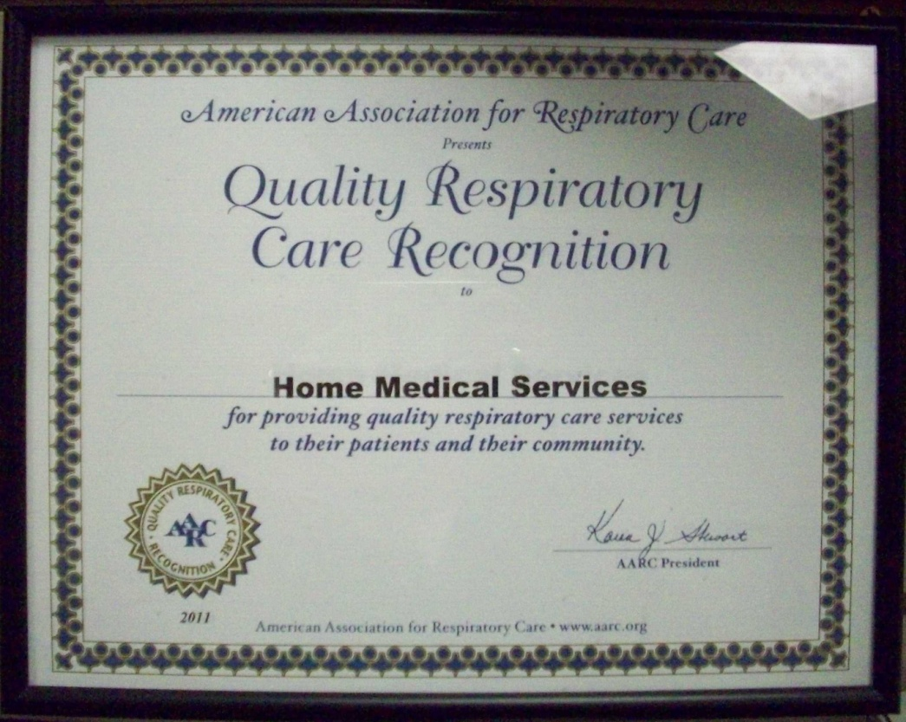
RTs are Humble Servants
“It sounds great!! Wow, you make us sound so wonderful. Thanks.
Thank you for letting us be a spotlight with the KRCS.”
Becky
Via Christi Home Medical Services

Slide 22
Continuing the Legacy
“…thank you very much for doing these sorts of things. I think this is exactly what I was hoping to accomplish during the days before internet in the book newsletters, get the news out, and promote the local profession in pictures, stories.”
Stan Munsch
Director, HaysMed

Slide 23
State Society Fan Club
Recognition…
Therapists are Humble Servants & Deserve Recognition!
Tell the world about the amazing therapists in your state.
Fulfill the Need of RTs to Stay Connected
Site Visits
Share stories online.
Discover the history, passion and talent of RTs in your society!!!

