Slide 1
Annual retreat to develop, implement and revise strategic plan
Claire Aloan and Sheri Tooley-Peters
Delegate, New York

Slide 2
Overview
Year 1 2006-7: Getting started: mission/core values/goals
Year 2 2008: Refining the plan: core strategies and tactics
Year 3 2009: Filling in the blanks, updating and revising
Future plans
  Complete all initiatives
  Communicate to membership
  Use strategic plan as basis for board meeting

Slide 3
Year 1: Getting Started
Board members interested in developing strategic plan
Talked to Garry Kaufmann about facilitating, based on his experience
2 day retreat scheduled for January 2007, to include BOD meeting and strategic planning session
Developed Mission Statement, Core Values, and Goals

Slide 4
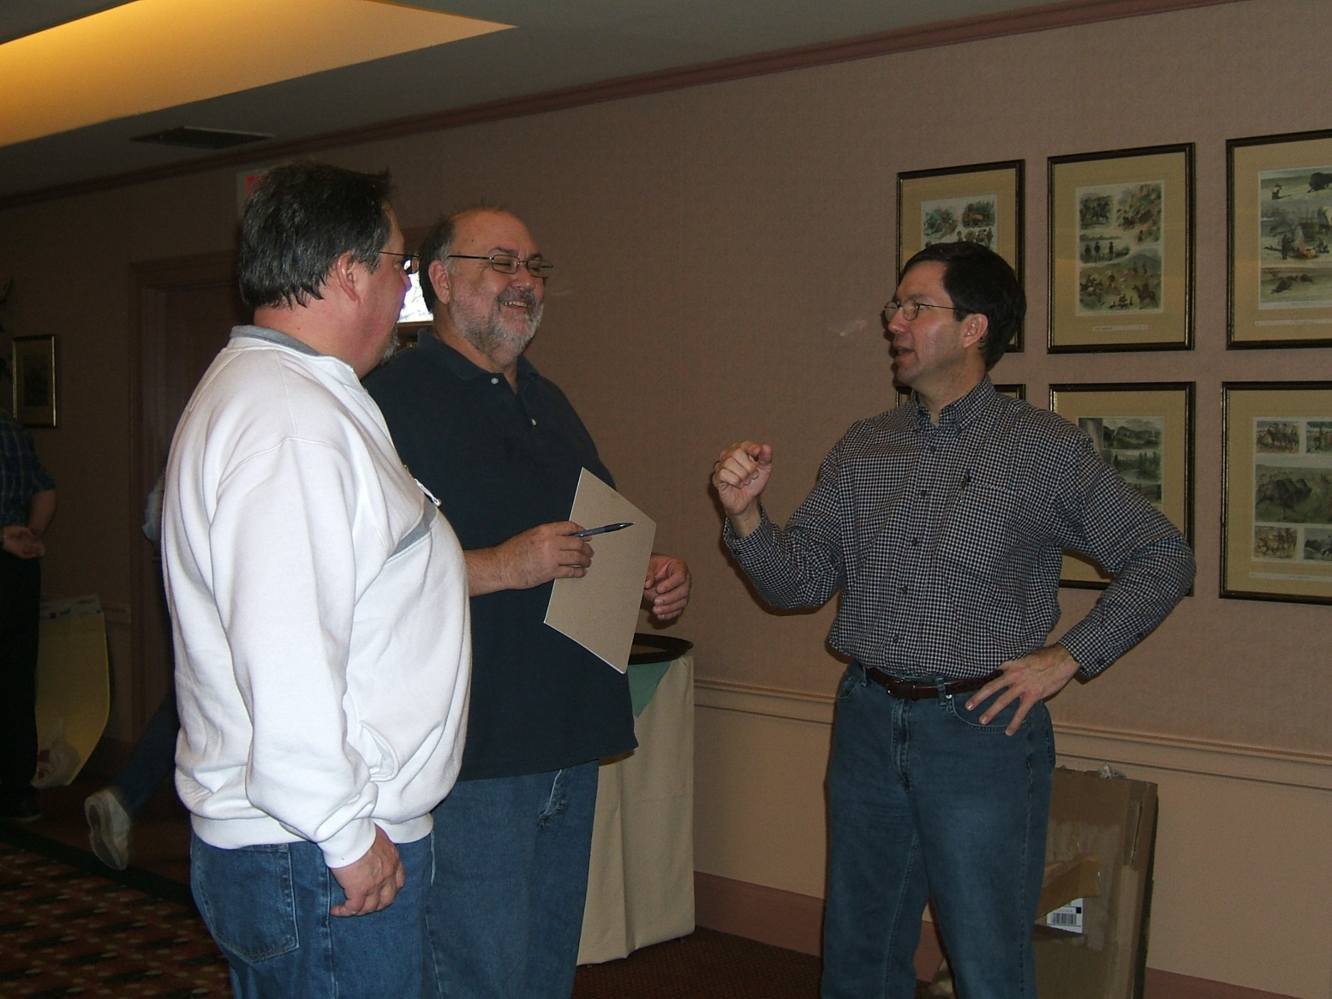
Garry kaufmann facilitates

Slide 5
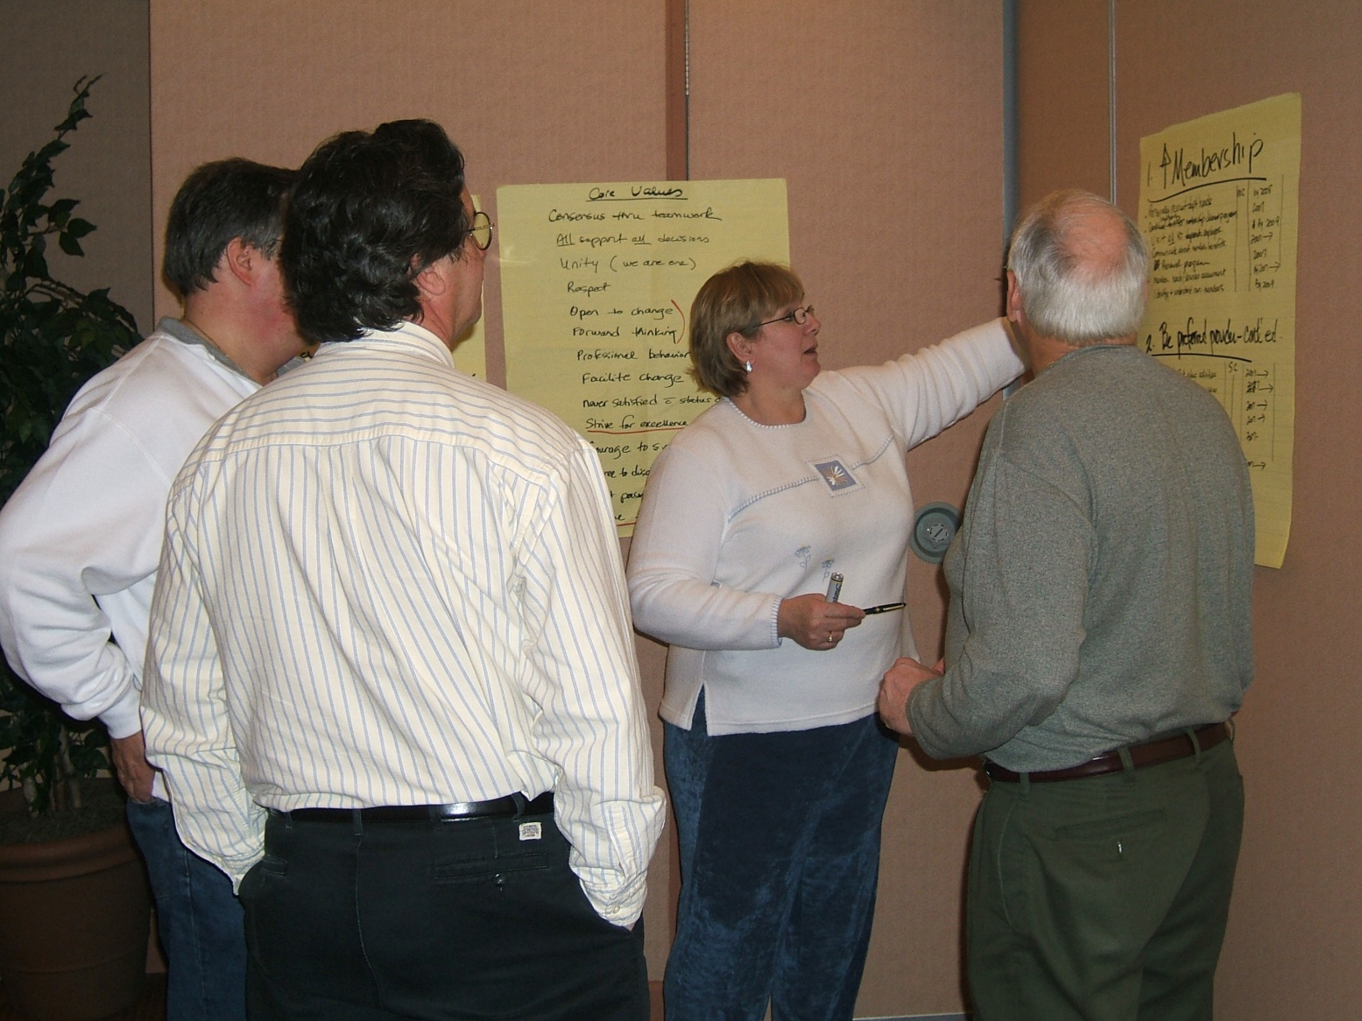
Brainstorming

Slide 6
Getting started: mission statement
The NYSSRC, an affiliate of the American Association for Respiratory Care, is the professional association of respiratory therapists, representing respiratory care in New York State. The NYSSRC promotes excellence in patient care, encourages professionalism, and advocates for patients, their families, the public, the profession and the respiratory therapist.

Slide 7
Getting started: core values
Teamwork for the Greater Good
Inclusiveness
Courage
Accountability
Fiscal Responsibility
Open Communication
Professionalism
Progressive Attitude
Strive for Excellence
Have Fun!

Slide 8
Getting started: goals
Increase membership
Be the preferred provider for quality respiratory care continuing education
Support formal Respiratory Care Programs in NYS
Unify the state society.
Promote leadership development
Maintain fiscal stability
Increase student involvement in NYSSRC
Support and encourage evidence-based respiratory care
Develop, implement and maintain a strategic plan
Provide advocacy for therapists, patients, and the public.

Slide 9
For each goal:
Plan
Responsible party
Timeline
Measure

Slide 10
NYSSRC Strategic Plan: Initial Report 1/6/07
Goal | Plan | Responsible Party | Timeline | Measure | Status
1. Increase membership | Personally recruit department managers | Membership Committee | By 2008 | Growth in manager memberships over time
 | Improve membership discount program |  | By 2007
 | Visit all RT employers in NYS |  | By 2009 | % completion of visits
 | Communicate about member benefits |  | 2007 and ongoing
 | Develop a renewal program |  | 2007
 | Assess members regarding needs and services |  | 2007 and ongoing
 | Identify and understand non-members |  | By 2009
 | Develop a member recognition program |  | 2007

Slide 11
2007 progress
Used goals to update policies and procedures
Updated plan during June and September BOD meetings
Determined needs for revision at 2008 retreat

Slide 12
3. Support formal Respiratory Care programs in NYS | Develop scholarship programs | Awards Committee
 | Update and maintain links to all schools on the web page | Education Committee and Webmaster | 06/07 | Review of website | Suggest that more information should be available on website
 | Develop speaker lists | Program Committee | 2007 | Development of lists
 | Work towards counselor meetings (State and regional) | Education Committee | 2007 | Attendance at counselor meetings | Education committee to develop list of state and regional guidance counselor meetings in NYS by 09/07
 | Publicize available opportunities for students and graduates | Education | 2008 | Publications
4. Unify the state society | Central treasury plan | Budget and Audit Committee | 06/07 | Implementation
 | Annual Planning Session | President | 06/07 | Implementation
 | Consistent state society location | Symposium Committee | Through 2010 | Meeting schedule | Completed
 | Develop a manager/BOD joint meeting, with ? free registration and ? CEU’s | Program Committee | 01/08 | Meeting scheduled. | Draft proposal for joint meeting to be presented 09/07

Slide 13
2008: year two
Annual retreat in January
Determined need to streamline and focus plan
Developed 4 core strategies:
  Organizational viability
  Advocacy
  Membership
  Education
Developed tactics for each strategy

Slide 14
Core Strategy: Organizational viability
Tactic: Leadership development
INITIATIVE | ACTION | WHY | TIMELINE | PERSON RESPONSIBLE | OUTCOME MEASURE(S)
Student mentors | BOD member assigned to each school | Increased visibility of NYSSRC to schools and students to attract new members | 4/08 | Chuck/Sheri | There will be a list of BOD members and their assigned schools
Progress & Transition | Presentation with handouts to each new BOD | Insure understanding of history of BOD and strategic plan to move forward | Bi-Annually | Chair of Progress & Transition Committee | There will be a presentation every other January to the BOD
Development of Managers’ Group | Establish managers’ listserve | Increase membership and participation of department directors/managers | 2008 | Chair of Membership Committee | Functional managers’ list serve on our website.
Hospital and Homecare mentor program | 1 member of BOD assigned to each hospital & homecare ag. | Continue to increase communication between BOD and members | 2008 | Chair of Membership Committee | There will be a list of BOD members and their assigned organizations
Student Seminars | Bi-Annual Seminars for all RT students in NYS | Recruitment for hospitals/facilities and introduce students to benefits of membership | First in 2009 | Chair of Seminar Committee | There will be a student seminar held next calendar year.
Speakers Bureau | Compile list of experts & topics | Know who the experts in given topics are in your area | 2008 and ongoing | Chair of Seminar Committee | There will be list of speakers an their areas of expertise by the end of 2008
Mentor chapter volunteers | BOD members assigned to mentor specific individuals | Experienced board member to teach new members for ongoing chapter/state activities to “carry the torch” | Ongoing | Chapter Presidents | Chapter presidents will have lists of mentors and their assigned protégés

Slide 15
2008: progress!
Distributed revised plan to BOD members
Added Strategic Plan review to BOD agenda
Reviewed and updated plan at June BOD meeting

Slide 16
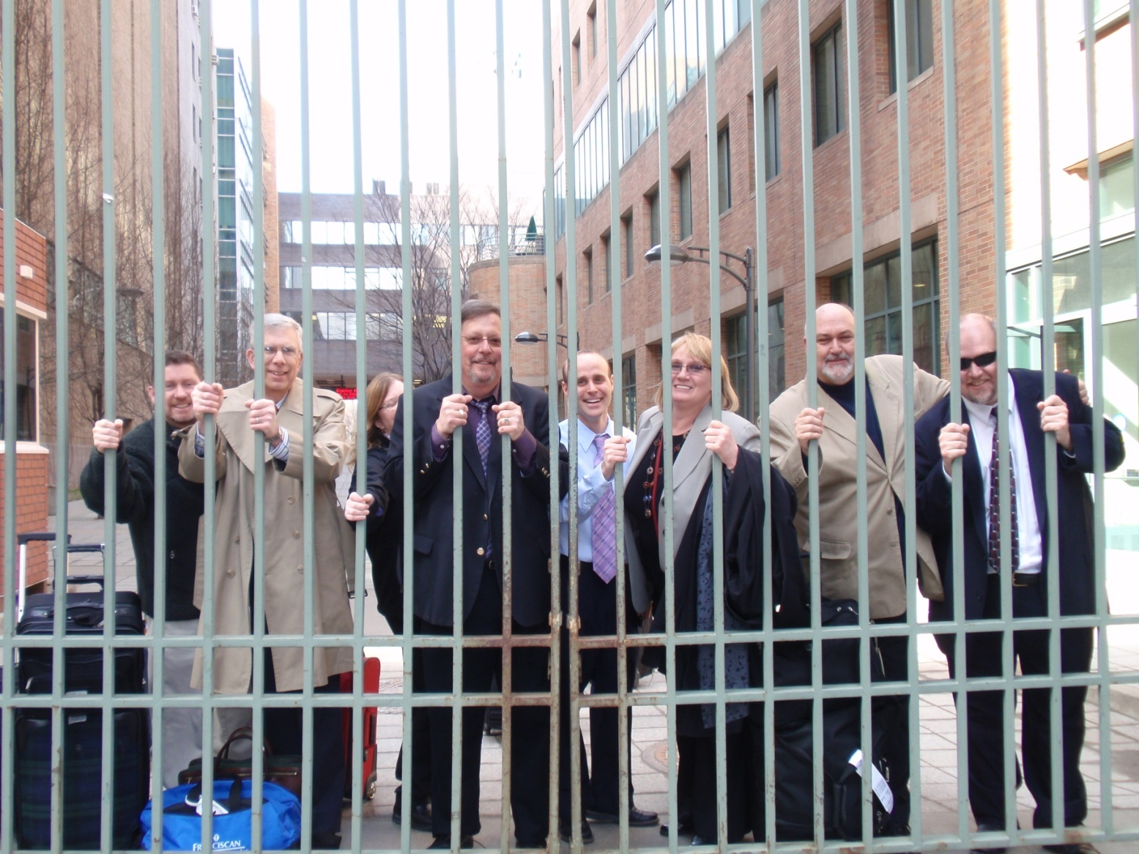
2009: the work continues

Slide 17
2009: retreat
Continued to review progress on each initiative
Revised and updated
Prior to meeting, action items distributed to each responsible group e.g., BOD, Officer, Committee Chair
Also distributed annotated version with all suggested changes, deletions, etc.
Working groups, consensus on each item

Slide 18
Membership Committee Strategic Plan Initiatives January 2009
Development of Managers’ Group | Establish managers’ listserve | Increase membership and participation of department directors/managers | 2008 | Chair of Membership Committee | Functional managers’ list serve on our website.
Hospital and Homecare mentor program | 1 member of BOD assigned to each hospital & homecare ag. | Continue to increase communication between BOD and members | 2008 | Chair of Membership Committee | There will be a list of BOD members and their assigned organizations
Visit hospitals/ education programs | Recruit volunteers | Increase number of members & our ability to affect issues | 12/08 | Membership | Number of visits/ %
Director-to- Director contact | Finalize director list | Need to determine membership status | 9/08 | Membership | There will be a complete list of all department directors in New York State
Membership at seminars | Finalize and implement policy | Consistency among chapters | 4/08 | Membership | There will exist a policy for attracting members at educational seminars
Departmental recognition for membership | Develop process and procedure | Reward people for being AARC members | 9-08 | Membership Joe McDonald | A policy will exist
FAQs | Develop FAQ sheet | Help recruiters answer questions- uniform presentation of information | 6-08 | Membership & Marlene(?) | FAQ sheet available
Personal contact/reminders | Utilize list and send letters (using template) | Personal contact improves retention | 6-08 | Membership | Number of letters sent
Individual recognition | Develop a recognition program with levels | Encourage retention, recognize longevity | 4-08 | Membership | Existence of a completed program
Links to other professional web sites | Add to web site in appropriate areas | Membership support | Change quarterly as needed | Membership Committee | # of hits on web sites

Slide 19
Core Strategy: Organizational viability Tactic: Financial Performance
INITIATIVE | ACTION | WHY | TIMELINE | PERSON RESPONSIBILE | OUTCOME MEASURE(S)
Central Treasury | Chapters move all assets to NYSSRC treasury | -To consolidate finances -To comply with best accounting practices | June, 2008 | President | Individual chapter accounts except for petty cash (immediate expenses) will no longer exist
Retain services of a bookkeeper | Quarterly Reports | Maintain up-to-date financial records | Quarterly | Treasurer | There will be a financial report at each board of directors meeting
Periodic (Internal)Audit | Yearly audit | To comply with IRS rules and regulations | May 15 each year | Treasurer | A yearly audit will be conducted prior to the middle of the fiscal year
Taxes | Filed annually | To comply with IRS rules and regulations and NYS law | May 15 each year | Treasurer | Taxes will be filed annually on time
Retain services of an accountant | To prepare annual (internal) audit & taxes | To assure good accounting practice | May 15 each year | Treasurer | There will be an accountant retained
Balanced budgets | Chapter reports by November 30 | For best practice in accounting. To assure membership of fiscal responsibility by BOD | Annual business meeting- January | Budget & Audit Committee | Prepared by chapters & sent to Treasurer by Nov. 30. To be presented to B & A Committee & BOD for approval prior to annual bus meet
Regional Seminar Profit | Set policy on % of bottom line | Assure that each meeting continues to be profitable | Every seminar | Seminar chair | Positive bottom line
Detailed reports of revenue/ expense | Reported to BOD quarterly at BOD meetings | Total transparency of finances | Ongoing | Treasurer | Prepared Quickbooks format reports from Book-keeper at BOD meetings.
Policies for fees/ vendors-registrations | Set uniform policy statewide | -Consistency of fees for vendors and participants -Increase revenue | Policy in place by 6/08 | Seminar Committee chair | Customer service Satisfaction survey Seminar evaluations

Slide 20
Core strategy: organizational viability
Tactic: Financial Performance
  9 initiatives, 9 developed 2 completed
Tactic: Leadership development
  7 initiatives, 7 developed, 0 completed
Tactic: Reorganization
  3 initiatives, 3 developed, 1 completed
(as of 01/09)

Slide 21
Core Strategy: Advocacy
Tactic: Public/Patients
  5 Initiatives, 5 developed, 0 completed
Tactic: Government
  5 initiatives, 0 developed, 0 completed
Tactic: Other Professions
  3 initiatives, 0 developed, 0 completed
Tactic: Respiratory Therapy Profession
  6 initiatives, 4 developed, 1 completed
(as of 01/09)

Slide 22
Core Strategy: Membership
Tactic: Recruitment
  8 initatives, 8 developed, 1 completed
Tactic: Retention
  6 Initiatives, 6 developed, 0 completed
Tactic: Camraderie
  7 Initiatives, 7 developed, 0 completed
(as of 01/09)

Slide 23
Core Strategy: Education
Tactic: General public
  6 Initiatives, 6 developed, 0 completed
Tactic: Hospital leadership
  3 Initiatives, 3 developed, 0 completed
Tactic: State/Federal Government
  3 Initiatives, 3 developed, 0 completed
Tactic: Schools
  3 Initiatives, 3 developed, 0 completed
Tactic: Respiratory Therapists
  7 Initiatives, 7 developed, 1 completed
Tactic: Other health professionals
  3 Initiatives, 3 developed, 0 completed
(as of 01/09)

Slide 24
Future Plans
Continue annual retreat and planning session
Complete development of all initiatives
Include strategic plan update in all BOD meetings
Refocus BOD meetings around strategic plan
Finalize plan and communicate to all members

Slide 25
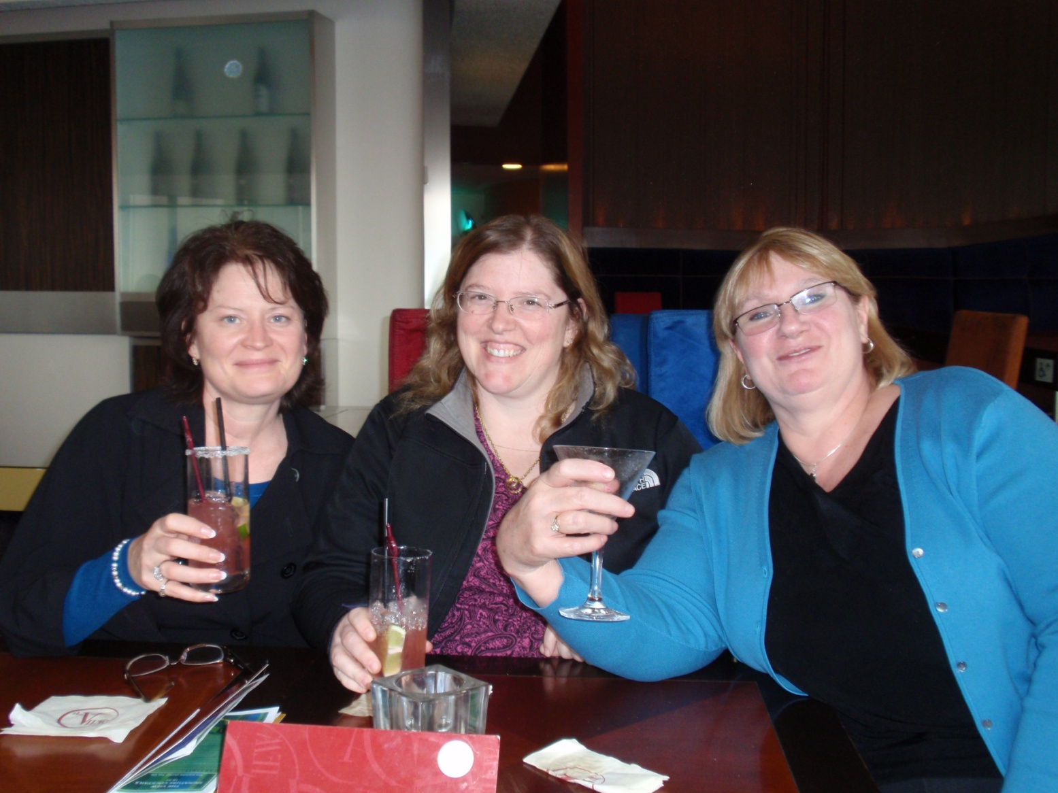
Surviving the strategic plan

