Slide 1
The Pressure to Make Sputum Bowl Fun Again How Connecticut Changed the Face of Their Game
Kerry McNiven
CT Society for Respiratory Care

Slide 2
History
Rick Bowen and Ginny DeFillipo and ???

Slide 3
Problems With Our Competition
Lack of:
Participation
Prepared teams
Commitment to go to national competition

Slide 4
Biggest Barriers to Participation
Wouldn’t know answers
Wouldn’t answer in time
Feeling stupid in front of peers/colleagues
Not enough beer/wine to boost their confidence and still be able to drive home

Slide 5
Changes Were Made
Became multiple choice
Became more of an individual competition than a team competition
Everyone in audience could participate
No one would know who answered what but would learn correct answer

Slide 6
Prizes
Game Cards
Everyone was given raffle tickets so periodically a number was drawn for a gift card
Given to anyone who got a particular question correct
Highest Score/Winner

Slide 7
How Did We do it?
Used a personal response clicker system
Educators changed questions to multiple choice and placed them in a PowerPoint presentation

Slide 8
How Can You do This at Home?
Find an education program that is using some type of audience response system and borrow their system
Rent a system (~$700.00)
Buy a system (~1,000.00)

Slide 9
Download the free software
This is what I use: http://www.einstruction.com
Take sputum bowl questions and make them multiple choice

Slide 10
Key Points
Emphasize that answers will not show who said what
The computer will “collect” answers and will calculate who wins

Slide 11
After Downloading the Software, Set up Your “Class”

Slide 12
Name the “Class” and Choose the Device

Slide 13
All Joined – Notice no Names Assigned

Slide 14
Make sure to Enable Add-Ins on Your Power Points
It will appear above you tool bar on the task pane
Add your questions
Be sure to select the correct answer
Test everything to make sure it works

Slide 15
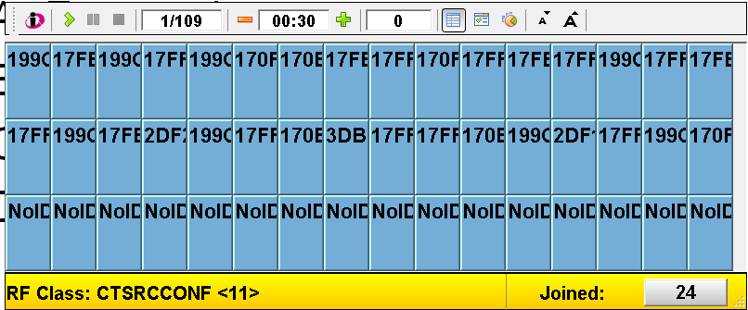
Start Up Slide

Slide 16
When Question Appears and has Been Read, Active the Timer

Slide 17
What Responses Look Like as Collected

Slide 18
The Correct Answers Are Shown

Slide 19
Determining the Winner
WINNER
Clicker 19

Slide 20
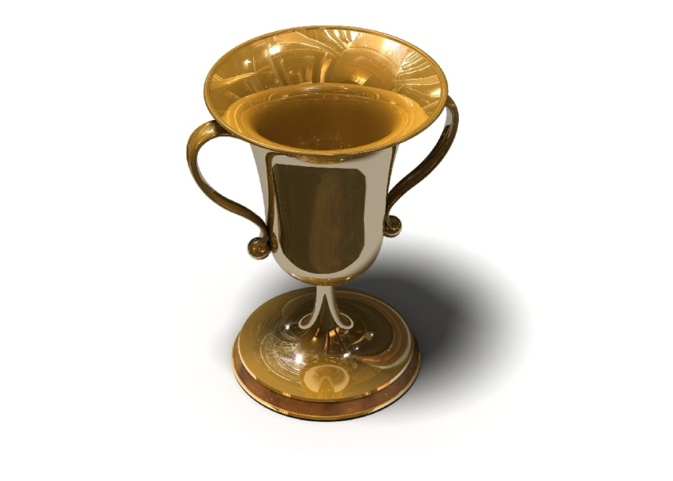
2012 HOD Alternative to Sputum Bowl Game
Welcome Players!!

Slide 21
Sending Answers
Press the lettered response button that represents your answer.

Slide 22
Transmission Status
If your Response was received, the Received LED will be green.
If your Response was not received, the Not Received LED will be red. Resend your answer.

Slide 23
Can I Change My Answer?
You can change your answer up to 3 times in the allotted time. Your third answer cannot be changed

Slide 24
When was the Social Intercourse Committee (SIC) born?
A. 1980
B. 1985
C. 1990
D. 1995
E. 2000

Slide 25
Where was most HOD meetings held?
A. Las Vegas, NV
B. Atlanta, GA
C. New Orleans, LA
D. St. Petersburg, FL
E. Vail, CO

Slide 26
In what year did the HOD first meet?
A. 1963
B. 1964
C. 1965
D. 1966
E. 1967

Slide 27
Who was the AARC President in 1997?
A. Charlie Brooks
B. Cynthia Molle
C. Kerry George
D. Diane Kimball

Slide 28
In what year was a general disaster fund established to aid AARC members involved in national disasters?
A. 1990
B. 1991
C. 1992
D. 1993
E. 1994

